Slide 1

SIT105 –Thinking Technology and Design Class 01
Dr. Nick Patterson
Dr. Frank Jiang
Nick.Patterson@deakin.edu.au
Frank.Jiang@deakin.edu.au
Part 1 – About this unit
Part 2 – Problem solving

Slide 2
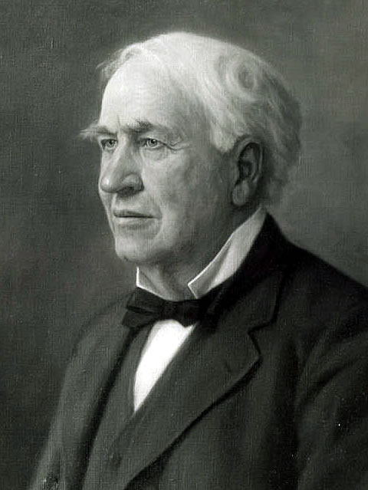
A quote to remember on your first week!
“Our greatest weakness lies in giving up. The most certain way to succeed is always to try just one more time.”
–Thomas A. Edison
One of the first and greatest critical thinkers!

Slide 3

[Video] History of Thomas Edison

Slide 4
Today’s Outline
First Half
What is this unit about?
What are the learning outcomes for SIT105 ?
Assessments
Text book?
Second Half
Introducing problem solving
Analyzing and problem solving real-world issues

Slide 5
First Half!

Slide 6
What is SIT105 about ?
The goal of this unit is to:
Applying critical thinking and problem solving skills.
From technical and non-technical perspectives.
Assist you in having a deeper understanding of problems revolving around technology.
Cultivate your reflective thinking – What? Why? When?
Reflective thinking is critical for success in situations which are unpredictable or complex when you are working with customers or clients.
Reflective thinking helps you to:
Develop an attitude where you ask questions
Identify areas for improvement
Be able to respond to new challenges
Applying what you have learned from one situation to other situations
Begin your journey of designing and developing technology.
How? By starting with designing algorithms.

Slide 7
Learning and Assessment – ULO’s
Your assessments are linked to your unit learning outcomes.
The unit learning outcomes = the specifics of what you are learning.
All unit learning outcomes are assessed.
Learning outcomes are observable, measurable, achievable and important!
Unit and course learning outcomes are professional accreditation requirements and standards, and relevant Australian Qualification Framework specifications.
Each course here at Deakin has clear pathways of outcome and accomplishment, with developmental support.
Unit learning outcomes are aligned with learning outcomes for your course and aligned with Deakin’s Graduate Learning Outcomes.

Slide 8
Unit Learning Outcomes
At the successful completion of this unit students can:
ULO1 Apply critical thinking techniques and IT discourse to identify and analyse problems from technical and non-technical perspectives.
ULO2 Develop strategies using generic and IT specific techniques to explore algorithms.
ULO3 Create algorithms using the input-processing-output model, defining diagrams and pseudo-code to demonstrate simple program design.
ULO4 Develop tests using assertions to evaluate and ensure correctness of algorithms

Slide 9
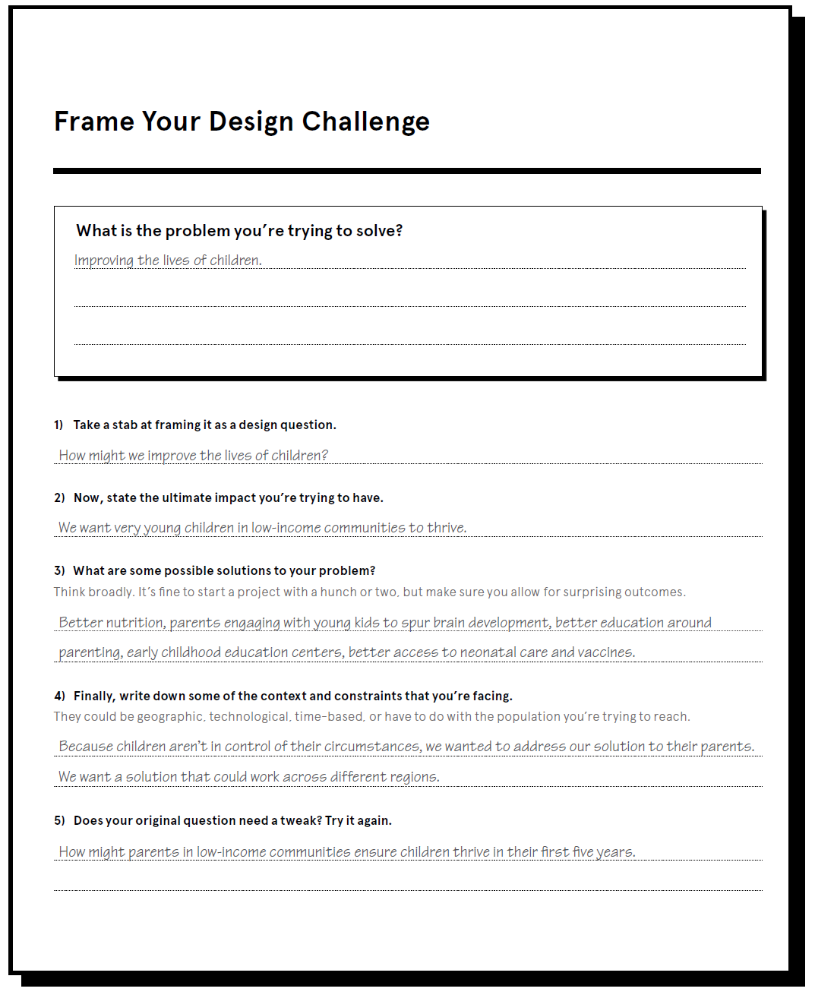
Frame your Design Challenge from IDEO Field Guide to Human Centered Design

Slide 10
How Might We … Check the quality of your Design Question
VIDEO: “How Might We …” The secret phrase innovators use
ppt videos\Class 01 - How Might We....mkv
A properly framed How Might We doesn’t suggest a particular solution, but gives you the perfect frame for innovative thinking
Now take a look at your How Might We question and ask yourself if it allows for a variety of solutions. If it doesn’t, broaden it.
Your How Might We should generate a number of possible answers and will become a launchpad for your Brainstorms
Make sure that your How Might We’s aren’t too broad. It’s a tricky process but a good How Might We should give you both a narrow enough frame to let you know where to start your Brainstorm, but also enough breadth to give you room to explore wild ideas.
From The Field Guide to Human-Centered Design - IDEO
Notes:
Alternative – show the How Might We video then discuss these points.

Slide 11

Text Books
We will use this textbook for your readings in and outside of class.
Please refer to the QQ class messages for details of the two reference books

Slide 12
Classes and Practical’s
So we will have two different kinds of interaction here in this unit.
Classes (entire student group)
For the first 5 classes we will think about critical thinking and problem solving revolving around different technology themes. We will have multimedia, activities and group discussions on these topics, linking in the theory.
The following 5 classes, we will pursue your learning of constructing algorithms (your first step into more hands on technology). This will be a combination of me teaching theory and some discussion points.
Finishing with a final week of exam revision.
Workshops (divided into smaller groups)
First class will be an introductory session to ease into things.
First, we will use these sessions to continue our learning on the class topics, focusing on group work activities, discussion questions and problem solving.
The next 6 classes, we will focus on writing algorithms, starting off very easy and finishing with more advanced.

Slide 13
Second Half! Problem Solving & Future Medical Technologies

Slide 14

Today’s Outline Medicine and Technology
Problem solving introduction
Research: Problem solving techniques
Problem 1: 5 future medical technologies
Activity: Define problem solving techniques!
Problem 2: Technology failure
Problem 3: Hacking
Readings

Slide 15

Problem Solving Intro
The world of Information Technology is full of problems, and decisions, but many people do not have the appropriate skills to manage them.
As problem solvers we try to improve the actual state of an IT project by finding an answer or a solution to a problem.
One way which can really boost our problem solving skills is when we work in a team to solve problems.
This can often be more beneficial than individual.

Slide 16
Problem Solving… get specific!
When we think of problems in broad terms, it makes them much harder to solve!
My internet download speed sucks!
Everything on my phone is not working!
What you want to do is try to hone in and obtain key facts.
This can help you to get to the key issues and find out what you need to solve exactly.

Slide 17

Problem Solving… get specific!
You want to define your problem and its severity as precisely as possible!
By doing this, you will be:
Assessing the current (actual) state of affairs
Specifying the desired (ideal) state of affairs (goals)
By doing this, it can help to set your technological problem on the pathway to being solved!

Slide 18
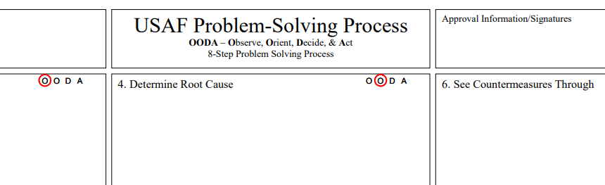
Problem Solving Process …..An example from the U.S Air Force
Let’s check out the process that the military uses to solve problems!
https://www.airuniversity.af.edu/Portals/10/eSchool/documents/Support%20Center%20Material/A3_Problem_Solving_Brochure.pdf

Slide 19
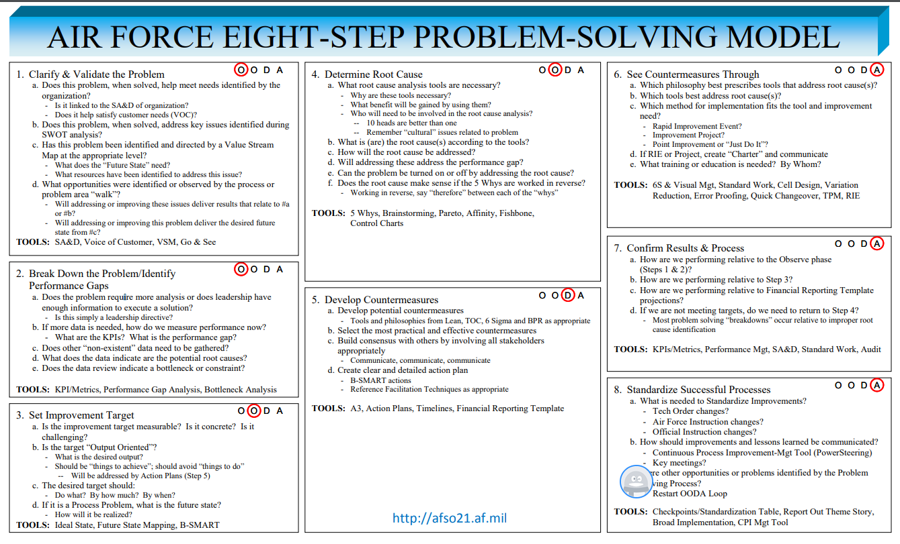
Problem Solving Process …..An example from the U.S Air Force

Slide 20

Problem Solving Methods?
So, why do we need them?
To help us figure out solutions to problems in the most effective and efficient way.
As there is not always 1 way to solve a problem.
Often work in IT revolves around solving problems to come up with a solution for a client.
We have a number of techniques at our disposal to do this.

Slide 21

Problem Solving Techniques What is the list?
Full List of Techniques
Abstraction
Analogy
Brainstorming
Divide and Conquer
Hypothesis Testing
Lateral Thinking
Means-Ends Analysis
Method of Focal Objects
Morphological Analysis
Reduction
Research
Root Cause Analysis
Trial-and-Error

Slide 22
Class Activity- Define the Problem Solving Techniques
Using each row of the class:
I will assign you one of the problem solving techniques.
Give you a piece of paper and pen.
Each person in each row write 1 word to start the definition of the given problem solving technique.
Everyone writes only 1 word, which proceeds the previous written word.
With some luck you will come up with a definition ☺
We will check them versus the correct definition.

Slide 23

Use one or more of the problem solving techniques you discovered, and come up with a list. Let’s give it a go! What are the 5 in your list, and what problem solving technique did you use to figure them out?
What you think the 5 most popular future medical technologies might be!
Problem 1

Slide 24
Solution: So what are five popular new medical technologies?
Problem 1 Solution
There is many new medical technologies coming out but here are five popular ones:
Robots –The surgeon sits at a computer station and directs the movements of a robot.
Exoskeleton suits – to allow partially-paralyzed individuals to walk again.
Body sensors - to monitor everything from sleep apnea to blood pressure.
3D Printers – to manufacture medical equipment, prostheses, or even drugs.
CloudHealth - Online access to patient personal health information.

Slide 25
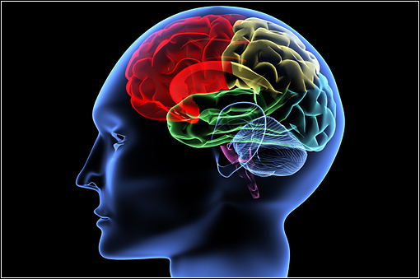
Possible Approach: Brainstorming with Research?
Brainstorming: You collaborated in a group to come up with ideas.
You may have used Research to discover possible answers (e.g. googling).
Problem 1 Approach

Slide 26
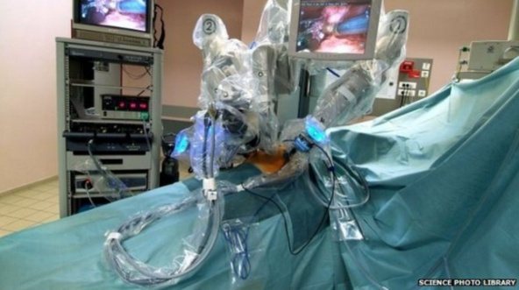
Robotic surgery linked to 144 deaths in the US
Problem 2
In the news!
A study into the safety of surgical robots has linked the machines' use to at least 144 deaths and more than 1,000 injuries over a 14-year period in the US.
They list 1,166 cases of broken/burned parts falling into patients' bodies, which contributed to 119 injuries and one death.
Uncontrolled movements and spontaneous powering on/off of the machines are said to have caused 52 injuries and two deaths.
Electrical sparks, unintended charring and damaged accessory covers are linked to 193 injuries, including the burning of body tissues.
And the loss of quality video feeds and/or reports of system error codes are said to have contributed to a further 41 injuries and one death.
Source: http://www.bbc.com/news/technology-33609495

Slide 27
Robotic surgery linked to 144 deaths in the US. How can this be avoided in the future?
Problem 2
In your existing groups come up with responses for the following:
What is the fundamental problem?
Determine the best problem solving approach to go with to help avoid this!
Why did your group choose this?

Slide 28

Robotic surgery linked to 144 deaths in the US
Problem 2 Approach
With this problem, an approach we could potentially use to solve this would be…
Abstraction!
Solving the problem in a model of the system before applying it to the real system.
Work out all the bugs in a model extensively before using it in real scenario’s

Slide 29

Future Medical: Hacking
Problem 3
Many medical systems, such as heart monitoring systems use embedded systems (smaller versions of popular computer operating systems).
We all know software (operating systems) can have errors, bugs or be hacked.
Imagine a hacker purposely hacking one of these devices and causing it to go haywire or ignore certain conditions. In order to put a patient in danger.
How can this problem be solved?
Discuss the problem with your groups.
Determine the best problem solving approach to go with!
Why did your group choose this?

Slide 30
Future Medical: Hacking
Problem 3 Approach
With this problem we could potentially use?
Morphological Analysis!
We could use this approach for the surgical robots, testing them before they are used in surgery’s.
Analyse outputs and interactions.
Work backwards from outputs towards the system internals.
Popular when you know very little about a system but you know the outputs/inputs!
We can figure out if the outputs are correct based upon the inputs.

Slide 31

Conclusion
In our theme this week, we looked at the future medical technology, its problems and its impact on society.
We looked at various problem solving techniques and applied them to various scenario’s.
Artificial Intelligence and hacking.
Assisted you in having a deeper understanding of problems revolving around future medical technology, as well as how to potentially work towards solving them.
Looked at what our ULO’s are for this unit.

Slide 32

Problem Solving Post-Class Reading!
As part of this weeks after class reading I have provided an article from the Journal of Problem Solving.
The process of Solving Complex Problems!

Slide 33

Any Questions?
End of Class!
Read ‘The Process of Solving Complex Problems’ paper from the Journal of Problem Solving

